Slide 1

PowerProxy for Azure OpenAI
Timo Klimmer
Global Blackbelt AI, EMEA
Microsoft

Slide 2



Motivation
Chargeback to Customers' Customers
Performance Optimization
Custom Monitoring
Custom Content Filtering

Slide 3

PowerProxy for Azure OpenAI
Team, Use Case or User 1
...
Azure Open AI Service (PTU or PAYG)
Team, Use Case or User n
PowerProxy
PowerProxy for Azure OpenAI is an open-source component / "solution accelerator" by the AI GBB team which monitors and processes traffic to and from Azure OpenAI Service endpoints.
As transparent "man-in-the-middle", it enables
charge back to teams or use cases according to their actual consumption, esp. when shared Provisioned Throughput model (PTU) deployments are used
optimizing performance, for example by tweaking the max_tokens setting
custom monitoring, for example watching out for certain keywords
custom rate limiting
...and more.
Customers can freely use and modify. However, it is not an official Microsoft product and therefore "as is".

Slide 4
Worth to Note
Enables sharing and cross-charging PTUs (Provisioned Throughput Units) across teams and use cases, even if AOAI's Azure AD authentication is used.
Is fully transparent = no code changes are required for usage, except replacing the endpoint address and key to AOAI.
Streaming responses are supported incl. token counting (actual vs. estimated).
Requests/responses are processed by customizable Python code via plugins. Highly extensible, commonly known programming language.
Can log only the data really needed, such as token counts, but not the sensitive prompts. But also more data than logged by default can be logged, eg. conversations.
Can run on almost any hosting service that runs a Python-based web server, for example Container Apps or Kubernetes. Reduces number of components involved = more performance over other approaches, less extra costs.

Slide 5









Scenario: API Key Authentication
connection to PowerProxy as if it was Azure OpenAI
Azure OpenAI key = team-specific key
Team or Use Case 1
optional:
secrets from Key Vault
Key Vault
Azure OpenAI key
(only known to administrators)
Azure OpenAI Service
Team or Use Case [...]
transparent server,
running on arbitrary host, eg. auto-scaling Container Apps
customizable via plugins
Team or Use Case n
Log Analytics
Power BI

Slide 6
Scenario: Azure AD Authentication
Token acquired from Azure AD
for specific user
Token acquired from Azure AD
for specific user
URL is specific for team/use case 1
Team or Use Case 1
team/use case is fixed per proxy instance
traffic processed by plugins, eg. to log to Log Analytics
Azure OpenAI Service
Token acquired from Azure AD
for specific user
Token acquired from Azure AD
for specific user
URL is specific for team/use case 2
Team or Use Case n
team/use case is fixed per proxy instance
traffic processed by plugins, eg. to log to Log Analytics

Slide 7
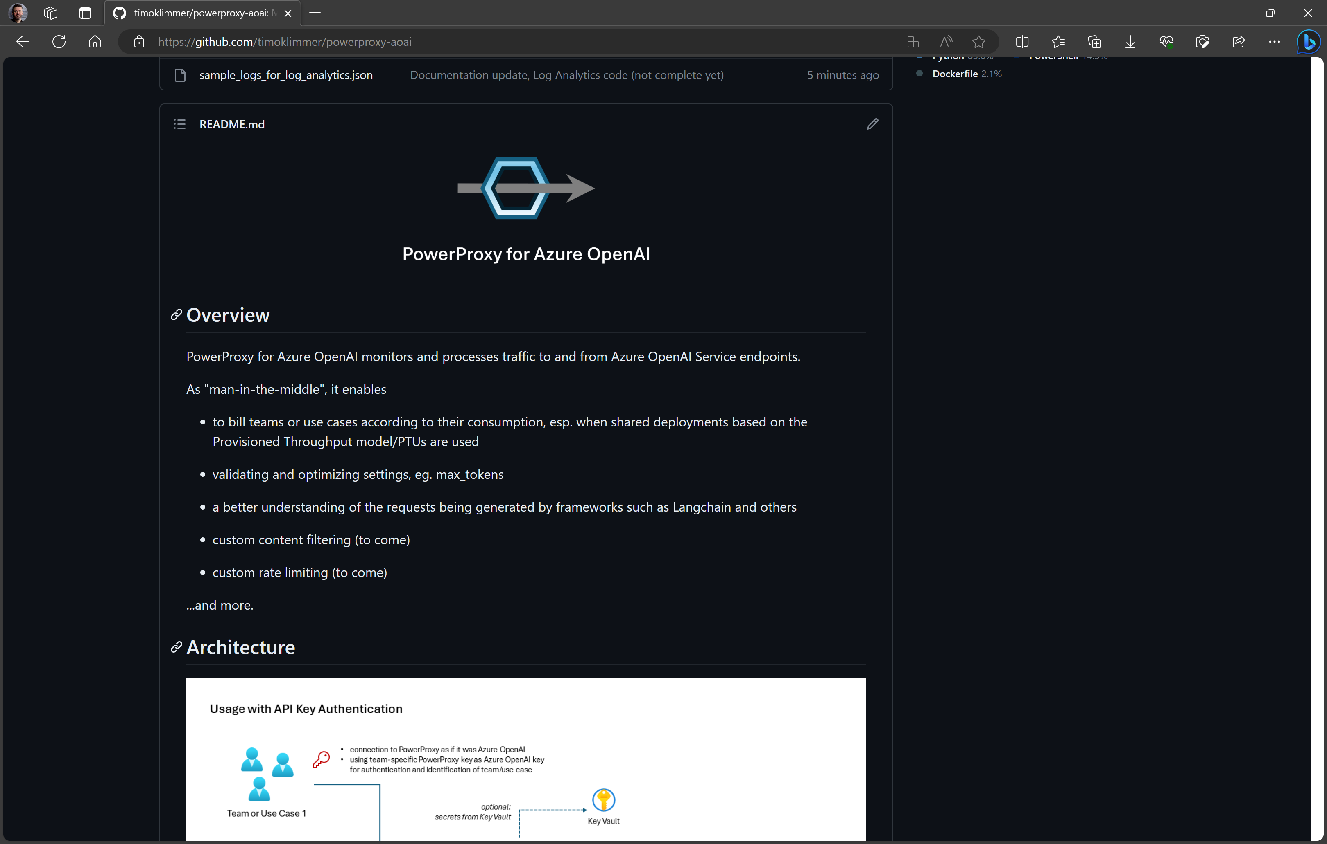
Github Repository - github.com/timoklimmer/powerproxy-aoai

Slide 8
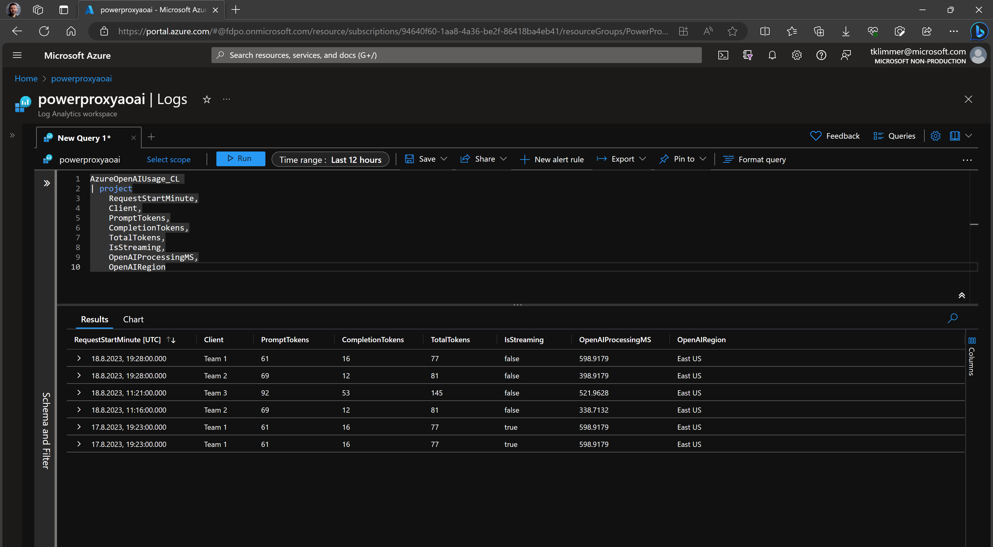
Usage Data in Log Analytics - Table

Slide 9
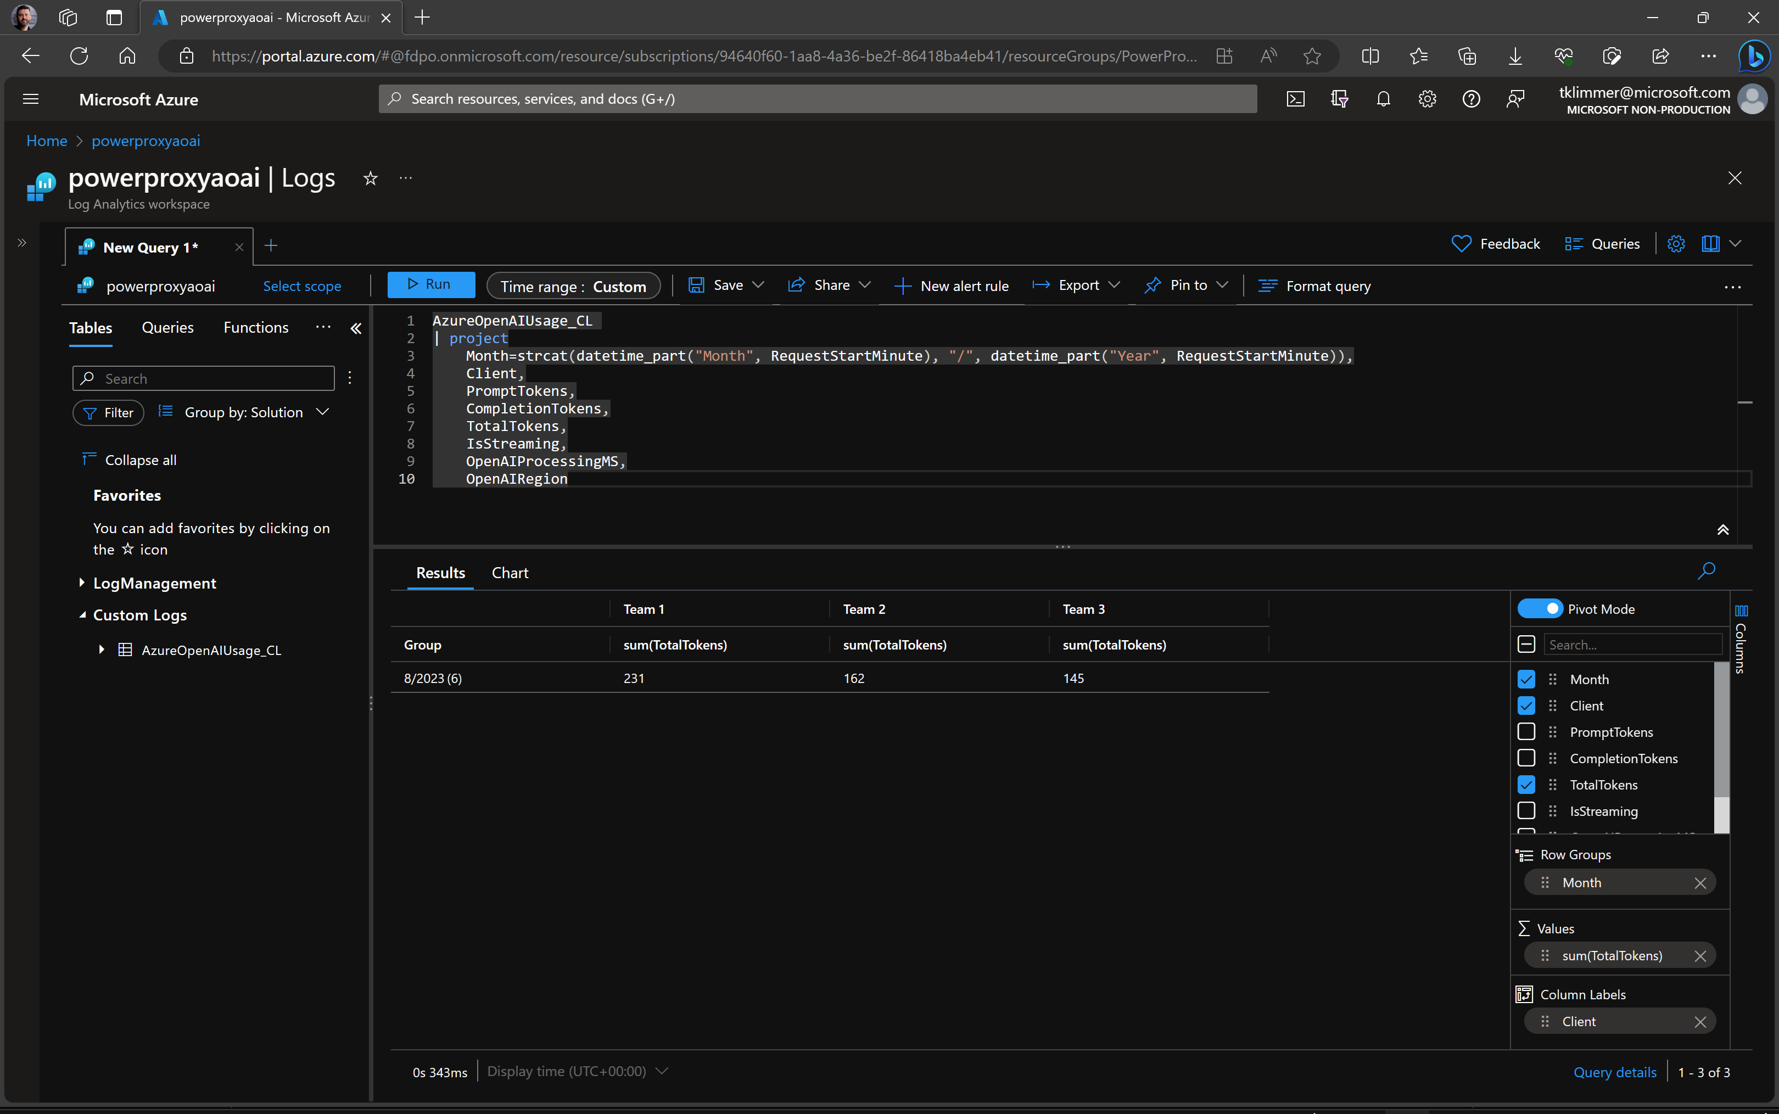
Usage Data in Log Analytics - Pivot Table

Slide 10
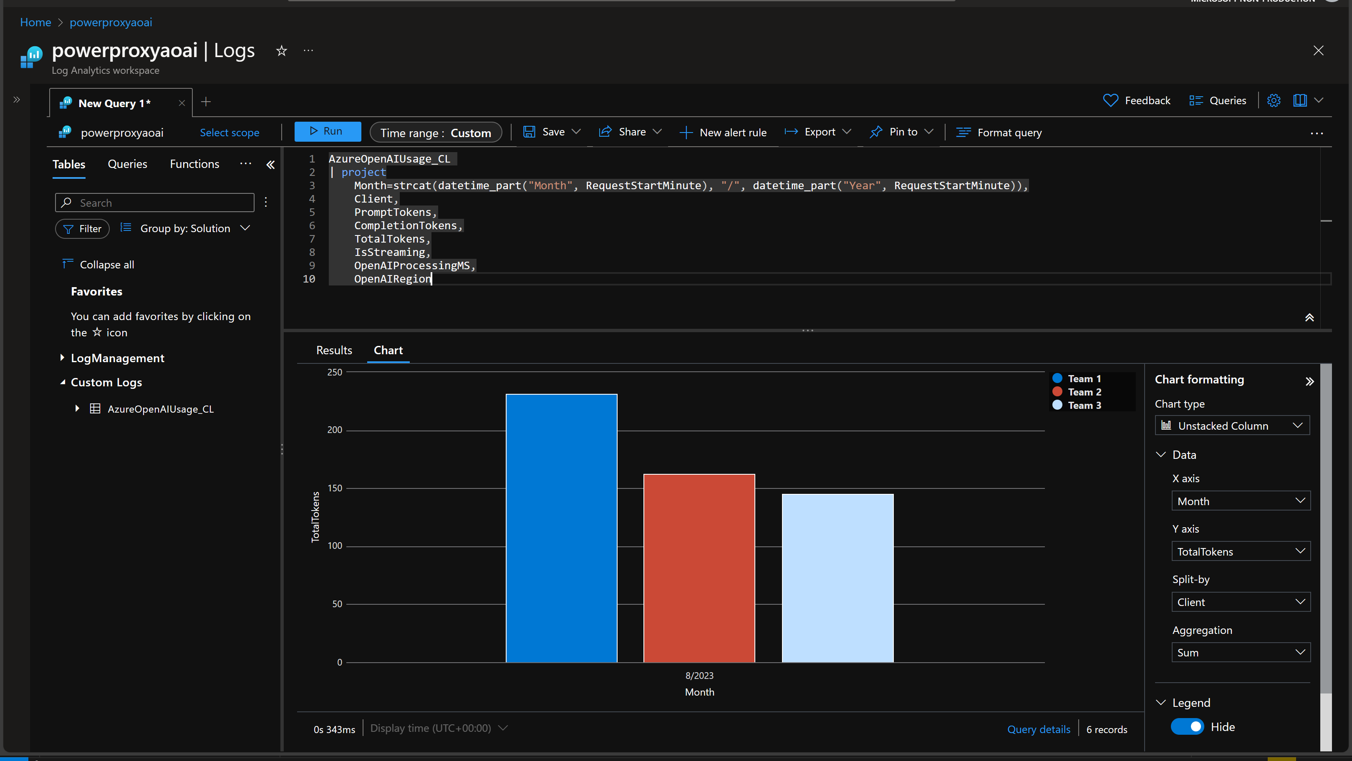
Usage Data in Log Analytics - Charts

Slide 11
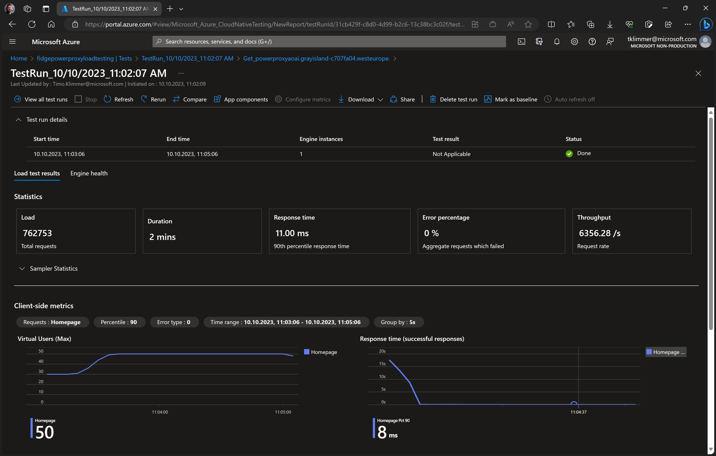

Proven Scalability of PowerProxy on Container Apps (Liveness Endpoint)

Slide 12
Q&A
Time to discuss - share your thoughts!

Slide 13
Final slide with logo

